Slide 1
Macro Event Based Stock Market Prediction
Praveen Raju
Rashpinder Jagait

Slide 2
Components of the Product
Sentiment Analysis
Language: Python
Models: Voting Classifier on XGBoost, Random Forest and SGD Classifier
Regression Prediction
Language: Python
Models: TensorFlow Sequential model with LSTM layers
Website
Languages: Typescript, HTML, CSS
Framework: Angular 8
Other macro-features
Reddit Posts
Sentiment Analysis
Regression Prediction
Predicted Stock Price
Time series stock price

Slide 3

Sentiment Analysis
Dataset Details
Model Details

Slide 4
Dataset Details
Using daily 25 most ‘hot’ posts on Reddit to be used as features
Using the change in stock price value as label for model training, where label is ‘0’ for decrease in value and ‘1’ if the price rose or stayed the same.
Remove contractions
Remove unwanted characters
Remove stop words
Capture synonyms
Count word and vectorize

Slide 5
Model Details
Trained and tested classification models (XGBoost, Random Forest and SGD), which gave a low accuracy. To optimize the prediction accuracy we are using majority rule classifier (Voting Classifier) for unfitted estimators using weighted prediction probability for final prediction estimation
XGBoost Classifier
w1
Reddit Posts
Sentiment
Dataset
RandomForest Classifier
w2
Voting Classifier
Sentiment Impact
Bayesian optimization
SGD Classifier
w3

Slide 6

Regression Prediction
- Dataset Details
- Model Details

Slide 7
Dataset Details
Reddit Sentiment Impact: This is sourced from the prediction from sentiment analysis on Reddit posts
Natural calamities: These have economic consequences impacting the stock market. Includes: wildfire, hurricane, flood, blizzard, snowstorm, tornado
Pandemic : Outbreaks always tend to have a negative effect on the market. For this demonstration, we have added Coronavirus, which could be enriched for 2020 and 2021 to be automatically picked in model training and testing
Annual Inflation Rate in USA: was added to capture the macro-economic factors that influence the stock market
Season of the year: to predict how seasonal stock market trend
Predicted
Label-encoded
Label-encoded
Normalized
One-hot encoded

Slide 8
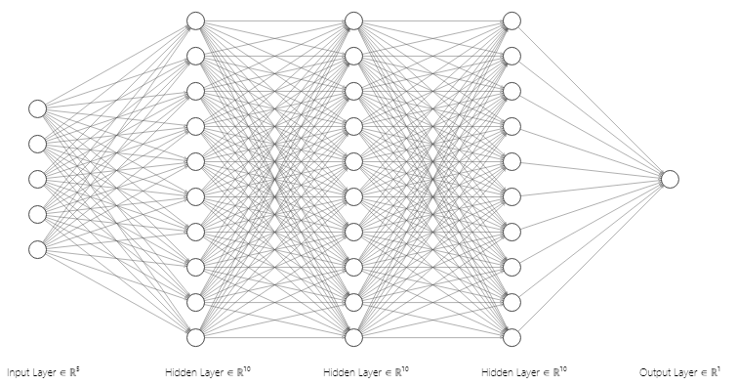
Model Details
Using the TensorFlow framework to create a sequential neural network containing LSTM layers to predict the time series dataset with dropout masks for regularization.
Adj Close Price
Inflation
Wildfire
Hurricane
Coronavirus
Blizzard
Flood
Spring
Summer
Winter
Fall
Sentiment Impact Prediction
Predicted Adj Close Price

Slide 9
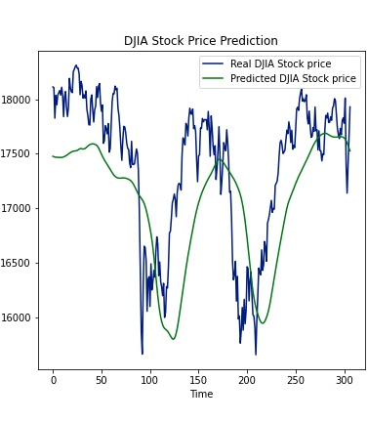
Predicted Vs Actual Stock Price Comparison

Slide 10

Thank You!
Please mail us for any queries: - rashpinderjagait@gmail.com - pcherianraju@gmail.com

